Slide 2
What is Sentiment Analysis?
Sentiment Analysis also known as Opinion Mining is a field within Natural Language Processing (NLP) that builds systems that try to identify and extract opinions within text. Usually, besides identifying the opinion, these systems extract attributes of the expression e.g.:
Polarity: if the speaker express a positive or negative opinion
Subject: the thing that is being talked about
Opinion holder: the person, or entity that expresses the opinion.

Slide 3
What Is an Opinion?
Before going into further details, let's first give a definition of opinion. Text information can be broadly categorized into two main types: facts and opinions. Facts are objective expressions about something. Opinions are usually subjective expressions that describe people’s sentiments, appraisals, and feelings toward a subject or topic.
Sentiment analysis, just as many other NLP problems, can be modeled as a classification problem where two sub-problems must be resolved:
Classifying a sentence as subjective or objective, known as subjectivity classification.
Classifying a sentence as expressing a positive, negative or neutral opinion, known as polarity classification.

Slide 4
Direct vs Comparative Opinions
"The picture quality of camera A is poor."
“The picture quality of camera A is better than that of camera B.”
Explicit vs Implicit Opinions
“The voice quality of this phone is amazing.”
“The earphone broke in two days.”
Sentiment Analysis Scope
Document level
Sentence level
Sub-sentence level

Slide 5
Types of Sentiment Analysis
1) Fine-grained Sentiment Analysis
Very positive
Positive
Neutral
Negative
Very negative
2) Emotion detection
Emotion detection aims at detecting emotions like, happiness, frustration, anger, sadness, and the like.
3) Aspect-based Sentiment Analysis
“The battery life of this camera is too short.”
4) Intent analysis
“Your customer support is a disaster. I’ve been on hold for 20 minutes”.
“I would like to know how to replace the cartridge”.

Slide 6
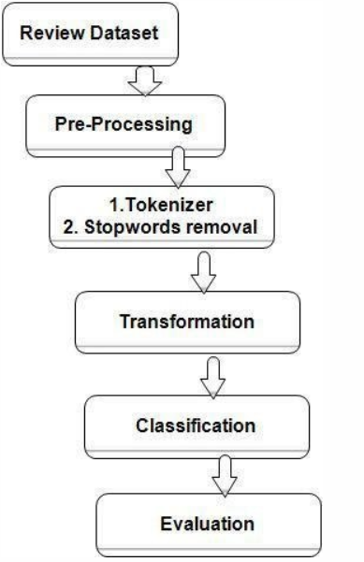

Slide 7
Pre-processing
An initial step in text and sentiment classification is pre-processing. A significant amount of techniques is applied to data in order to reduce the noise of text, reduce dimensionality, and assist in the improvement of classification effectiveness. The most popular techniques include:
Remove numbers
Stemming
Part of speech tagging
Remove punctuation
Lowercase
Remove stopwords

Slide 8
How to classify Sentiment?
Machine Learning
This approach, employes a machine-learning technique and diverse features to construct a classifier that can identify text that expresses sentiment. Nowadays, deep-learning methods are popular because they fit on data learning representations.
Lexicon-Based
This method uses a variety of words annotated by polarity score, to decide the general assessment score of a given content. The strongest asset of this technique is that it does not require any training data, while its weakest point is that a large number of words and expressions are not included in sentiment lexicons.
Hybrid
The combination of machine learning and lexicon-based approaches to address Sentiment Analysis is called Hybrid. Though not commonly used, this method usually produces more promising results than the approaches mentioned above.

Slide 9
